Slide 1
SPECIFIC ABSORPTION RATE CAUTIONER USING ANDROID
BATCH E15
Guide,
Mr.M. Mohan
BY
EZHILARASU N
GOKUL N
HARIHARAN D

Slide 2
INTRODUCTION
The EM radiation is measured based on Specific Absorption Rate (SAR). The human head is generally exposed to mobile phones operating at communication (GSM, CDMA) frequency bands. The radiation absorption analyzed through simulations by applyingfrequency domain. The specific absorption rate (SAR) was measured for different positions of mobile phone. SARs exhibited in much lower values as the mobile phone held in far position from human brain.

Slide 3
LITERATURE SURVEY
Rigorous Analysis and Evaluation of Specific Absorption Rate (SAR) for Mobile
Multimedia Healthcare
Ghufran Ahmed, Saif Ul Islam, Maham Shahid, Adnan Akhunzada, Sohail Jabbar,
Muhammad Khurram Khan, Muhammad Riaz, And Kijun Han
Ghufran Ahmed, Saif Ul Islam, Maham Shahid, Adnan Akhunzada, Sohail Jabbar, Muhammad Khurram Khan, Muhammad Riaz, And Kijun Han in their research mobile multimedia applications transfer multimedia data and generate huge amount of data. Due to the high data rate, heat generated from sensor devices is considerably high and results in thermal dissipation. This heat generated from nodes may result in sensitive tissue damage. Hence, to avoid any damage to body organs there is a need to analyze SAR. In this paper, an extensive analysis of SAR is provided. More over, a comprehensive overview of safety aspects and challenges is also elaborated. As discussed earlier, the tissues of a human body are sensitive to heat. Therefore, thermal impact of IoT devices must be considered while designing WBAN solutions in order to mitigate the risk of tissue damage. SAR is affected by various factors like change in the distance between node sand the current provided to nodes’ antenna. The position of the sink is also an important parameter for SAR. In this paper, all these aspects are evaluated rigorously.

Slide 4
LITERATURE SURVEY
A Review on SAR Reduction Methods Used For Mobile Application
Dhanesh.P, Jayesh George. M, Anoop.B.K
Dhanesh.P, Jayesh George. M, Anoop.B.K presents a study of different methods used for specific absorption rate (SAR) reduction and factors depending on the SAR value for mobile application. The presented studies provide useful information for future design of mobile handset antennas. The Size, position of the antenna, material used and some other parameters also decides SAR value. According to standardization regulation committee in different region SAR value should be maintained in any mobile phones. So that SAR value is a crucial point in antenna design. The studies on the SAR reduction methods for mobile application reveal the idea for designing healthy antenna's for mobile application. The efficient method to reduce the SAR is designing of meta materials. Size, position, thickness of an antenna also matters in case of SAR. SAR value is a important parameter in case of mobile devices. SAR is also a crucial parameter in antenna design.

Slide 5
LITERATURE SURVEY
The study of specific absorption rate (SAR) reduction in mobile phones using
materials and metamaterials.
Mohammad Rashed Iqbal Faruque, Mohammad Tariqul Islamand Norbahiah
Misran
Mohammad Rashed Iqbal Faruque, Mohammad Tariqul Islam and Norbahiah
Misran researched an reducing of specific absorption rate (SAR) with materials and meta materials attachment is investigated. The finite-difference time-domain method with lossy-Drude model is adopted in this study. The methodology of SAR reduction is addressed and the belongings of attaching position, distance, and size of ferrite sheet material properties, perfect electric conductor (PEC), and meta materials on the SAR reduction are investigated. Materials have achieved a 47.02% reduction of the initial SAR value while metamaterials achieved a reduction of 49.21% respectively for the case of 1 g SAR. These results propose a guideline to decide assorted types of materials and metamaterials with the utmost SAR reducing effect for a phone model. The EM interaction between an antenna and the human head with materials and metamaterials has been discussed in this paper. Utilizing material in the phone model, a SAR value achieved about 0.676 W/kg for SAR 10 g and with metamaterial, a SAR value of 0.737 W/kg for SAR 10 g is achieved. Based on the 3-D FDTD method with lossy-Drude model, it is found that the peak SAR 1 g of the head can be reduced by placing materials and metamaterials between the antenna and the human head. Metamaterials were designed from a periodic arrangement of SRRS. Numerical results can provide useful information in designing communication equipment for safety compliance.

Slide 6
TECHNOLOGY STACK
HARDWARE REQUIREMENTS
Processor Core -i3, 2.4 GHz
Hard disk -500 GB
RAM- 4GB
SOFTWARE REQUIEMENTS
Development Environment-Android Studio 4.1.3
Front End Language-Xml
Back-End Language-Java
Database-SQLite

Slide 7
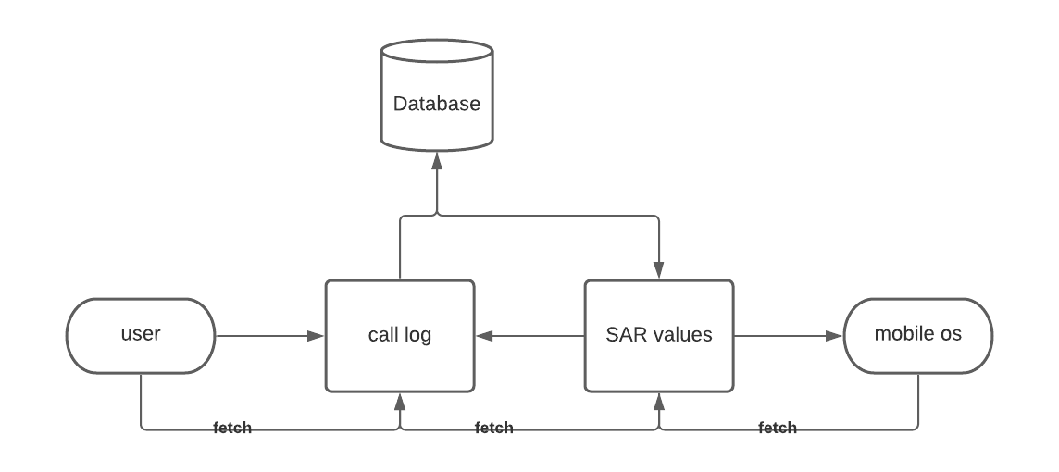
SYSTEM ARCHITECTURE

Slide 8
SYSTEM DESIGN-ER Diagram

Slide 9
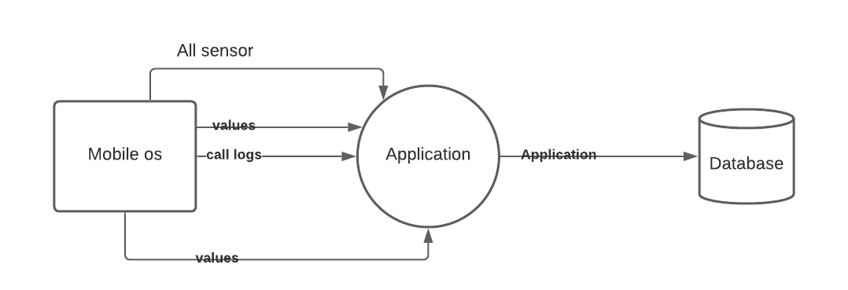
SYSTEM DESIGN-DFD

Slide 10
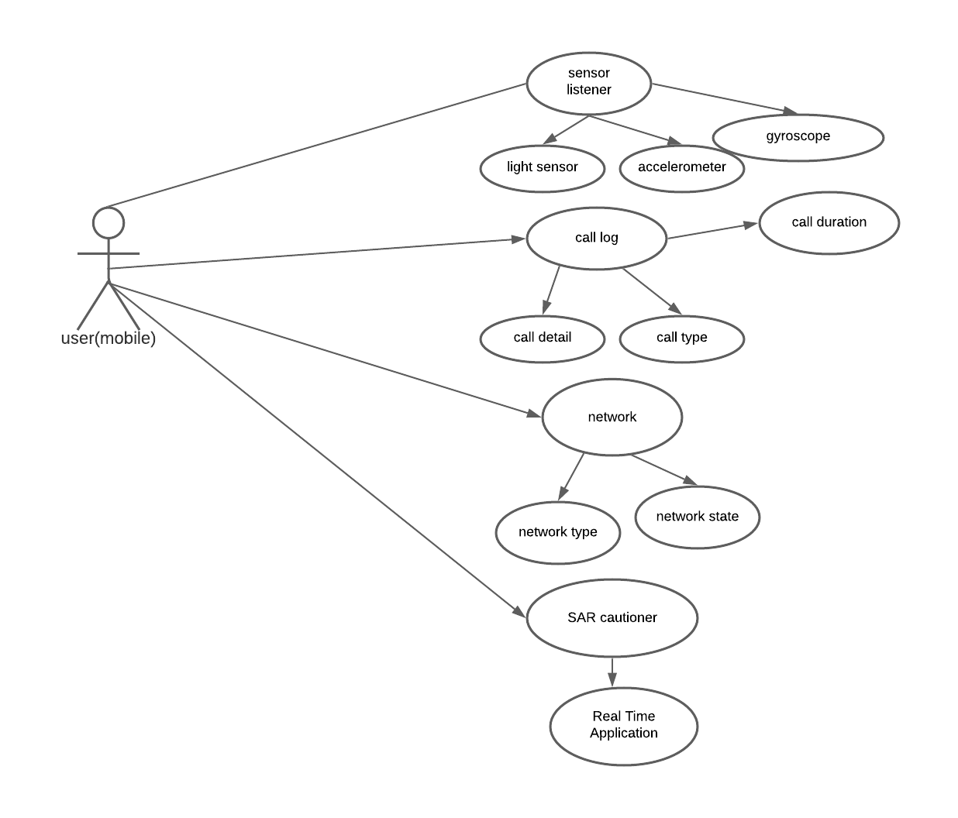
SYSTEM DESIGN-Use case

Slide 11
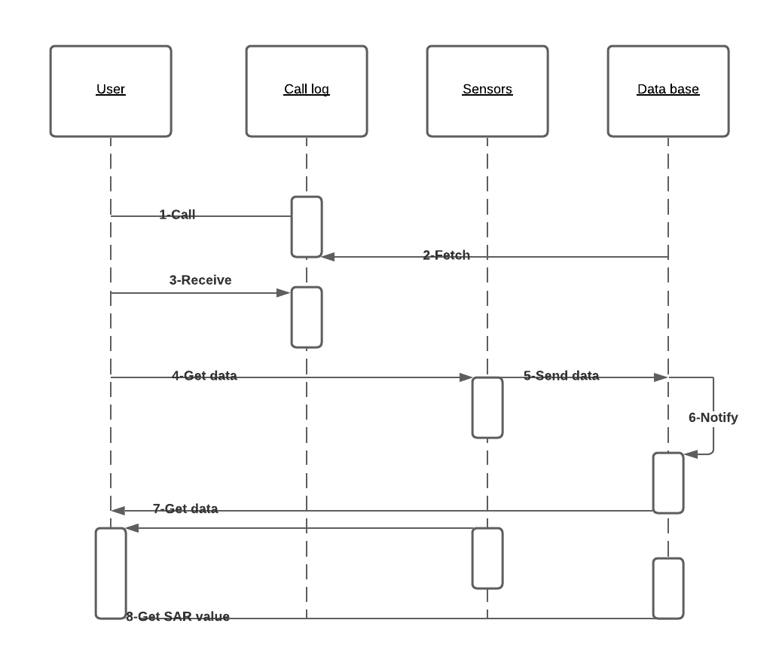
SYSTEM DESIGN-Sequence

Slide 12
MODULE DESCRIPTION
The Specific Absorption Rate modules functions namely:
User Call Log
The SAR application fetches the call duration and call type through which it calculates
the SAR value and checks whether it is in mentioned limits. With the help of the user call
duration we calculate the Actual amount of radiation that has passed through the human
brain. This module is one among the main module that is directly connected to the
sensors and DB where each call duration and its network state and charging status is
recorded.
SAR Monitoring DB
The Specific Absorption Rate stores the value of each time the SAR recorded in the Data
Base. It fetches the information from Sensor listeners and also the call duration log. It
processes the SAR values monitored for one whole week and displays the bar chart for the
above recorded values.There is also an option to check your phone SAR using the code
mentioned in the option. It also displays the circle with percentage of SAR passed

Slide 13
TESTING
Test Case Id | Test Cases | Priority | Input TesData | Test Case Description | Expected Results | Actual Results | Pass/Fai l
TU0 1 | Check phone SAR | A | Dial *#07# | Check user Mobile SAR | Get phone SAR | Phone SAR in Mobile Phones | Pass
TU0 2 | Dial Phone Call | A | Call Duration | Takes the Call duration | Check SAR within limits or not | Actual SAR Value | Pass
TU0 3 | Receive Phone call | A | Call Duration | Takes the Call duration | Check SAR within limits or not | Check SAR within limits or not | Pass

Slide 14
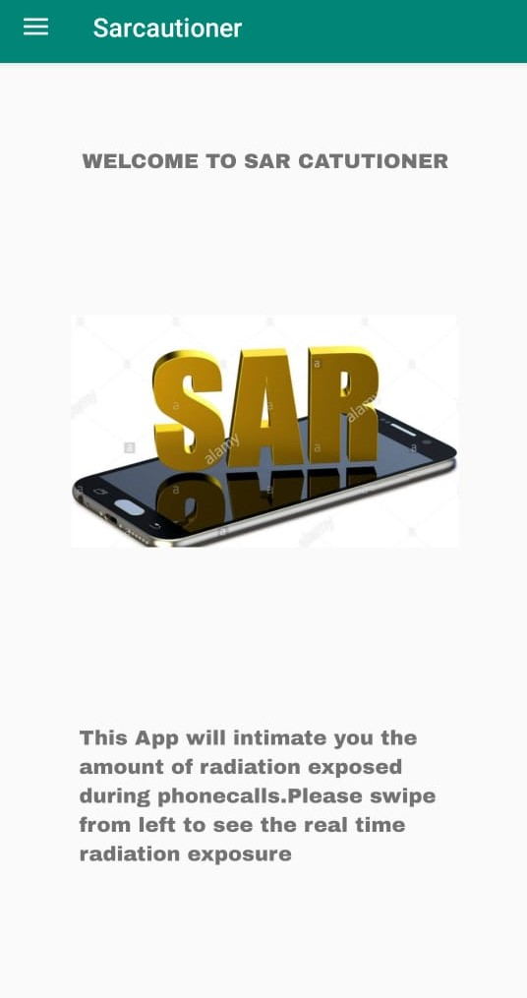
SCREENSHOT

Slide 15
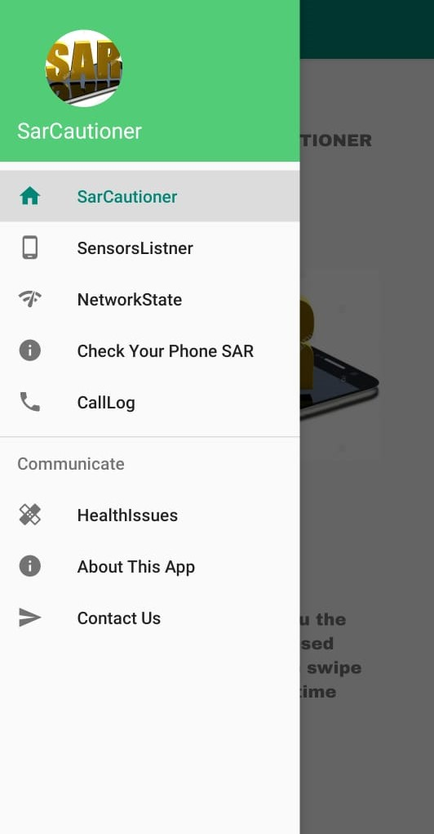
SCREENSHOT

Slide 16
SCREENSHOT

Slide 17
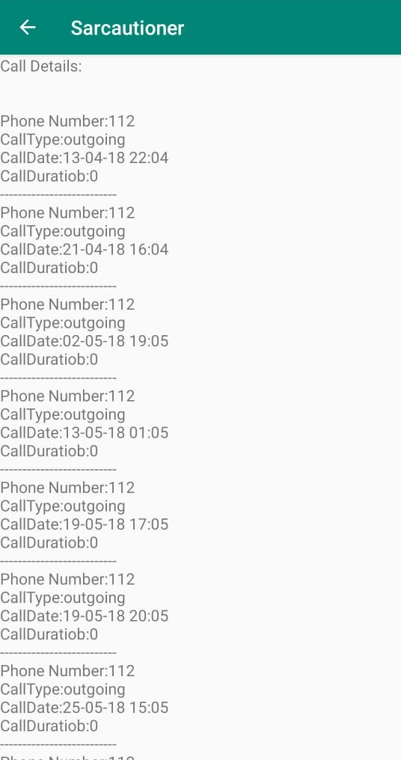
SCREENSHOT

Slide 18
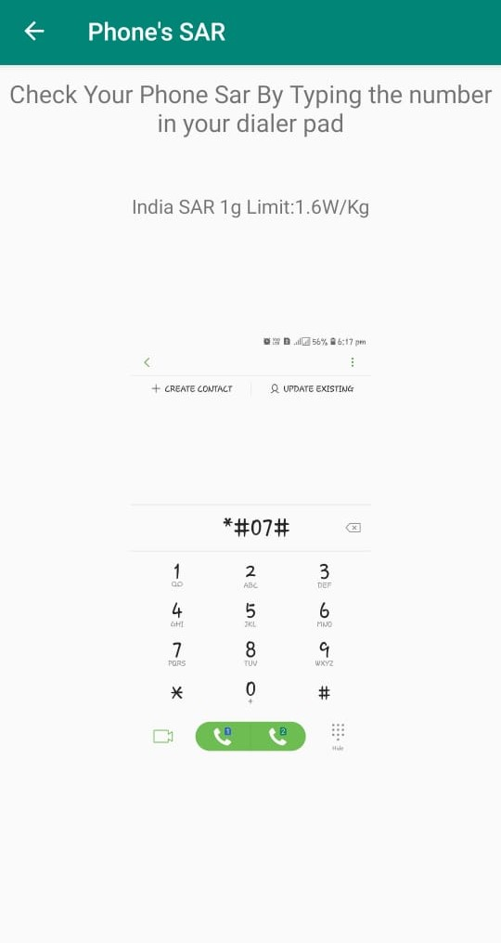
SCREENSHOT

Slide 19
CONCLUSION
This guidance system provides an easier platform for mobile users to control their usage of mobile phones during calls. Since it creates an awareness of the radiation passed through the human body and brain. This application also cautions the user not to use mobile phones in charging mode

Slide 20
REFERENCE
[1] T.-Y. Kim, S. Youm, J.-J. Jung, and E.-J. Kim, ‘‘Multi-hop WBANconstruction for healthcare IoT systems,’’ inProc. Int. Conf. PlatformTechnol. Service (PlatCon), Jan. 2015, pp. 27–28.
[2] S.-Y. Lee, J.-H. Hong, C.-H. Hsieh, M.-C. Liang, S.-Y. C. Chien, andK.-H. Lin, ‘‘Low-power wireless ECG acquisition and classificationsystem for body sensor networks,’’IEEE J. Biomed. Health Informat.,vol. 19, no. 1, pp. 236–246, Jan. 2015.
[3] G. Ahmedet al., ‘‘Health monitoring using WBAN: Topology design,routing and thermal issues,’’ inEnhanced Living Environments: FromModels to Technologies. London, U.K.: IET, 2017, p. 293.
[4] S. U. Islamet al., ‘‘Implanted wireless body area networks:Energy management, specific absorption rate and safety aspects,’’inAmbient Assisted Living and Enhanced Living Environments,C. Dobre, C. Mavromoustakis, N. Garcia, R. Goleva, andG. Mastorakis, Eds. Oxford, U.K.: Butterworth-Heinemann,2017, ch. 2, pp. 17–36. [Online]. Available:
https://www.sciencedirect.com/science/article/pii/B9780128051955000028
[5] G. Ragesh and K. Baskaran, ‘‘An overview of applications, standards andchallenges in futuristic wireless body area networks,’’Int. J. Comput. Sci.Issues, vol. 9, no. 2, p. 180, 2012

Slide 21
THANK YOU

